Slide 1
Cornerstone City Church Peninsula Plus Community Hoo Are Ya
12th October 2025

Slide 2
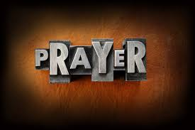

Slide 3
Thanksgiving
CCLI Song # 7199589
Nick Herbert | Taku Mudere | Zo Chilengwe
© Capitol CMG Genesis; Safe and Sound Music; Remaining portion is unaffiliated
For use solely with the SongSelect® Terms of Use. All rights reserved. www.ccli.com
CCLI Licence No. 33265

Slide 4
1/10
Enter in (Enter in)
His courts with praise (His courts with praise)
For He is greatly (He is greatly)
To be praised (To be praised)

Slide 5
2/10
Enter in (Enter in)
His courts with praise (His courts with praise)
For He is greatly (He is greatly)
To be praised

Slide 6
3/10
What shall we do
We shall lift up a shout
What shall we do
We shall praise Him
What shall we do
For our God made a way
We'll give Him our thanksgiving

Slide 7
4/10
Magnify (Magnify)
His Holy Name (His Holy Name)
For He is greatly (For He is greatly)
To be praised (To be praised)

Slide 8
5/10
Magnify (Magnify)
His Holy Name (His Holy Name)
For He is greatly (For He is greatly)
To be praised

Slide 9
6/10
What shall we do
We shall lift up a shout
What shall we do
We shall praise Him
What shall we do
For our God made a way
We'll give Him our thanksgiving

Slide 10
7/10
Even if the rocks cry out
We're gonna drown them out
With a louder shout of praise
Even when the battles roar
We're gonna praise You Lord
'Cause You are always worthy

Slide 11
8/10
You are worthy
Worthy of honour and praise
You are worthy
We'll sing it again and again

Slide 12
9/10
What shall we do
We shall lift up a shout
What shall we do
We shall praise Him
What shall we do
For our God made a way
We'll give Him our thanksgiving

Slide 13
10/10
We'll give Him our thanksgiving
We'll give Him our thanksgiving

Slide 14
Open The Eyes of My Heart
CCLI Song # 2298355
Paul Baloche
© 1997 Integrity's Hosanna! Music (Admin. by Integrity Music Ltd)
For use solely with the SongSelect® Terms of Use. All rights reserved. www.ccli.com
CCLI Licence No. 33265

Slide 15
1/3
Open the eyes of my heart Lord
Open the eyes of my heart
I want to see You
I want to see You

Slide 16
2/3
To see You high and lifted up
Shining in the light of Your glory
Pour out Your power and love
As we sing holy holy holy

Slide 17
3/3
Holy holy holy
Holy holy holy
Holy holy holy
I want to see You

Slide 19
Holy Forever
CCLI Song # 7201044
Brian Johnson | Chris Tomlin | Jason Ingram | Jenn Johnson | Phil Wickham
© Phil Wickham Music (Admin. by / Small Stone Media BV, Holland (Admin. in the UK/Eire by Song Solutions www.songsolutions.org))
Simply Global Songs (Admin. by / Small Stone Media BV, Holland (Admin. in the UK/Eire by Song Solutions www.songsolutions.org))
Capitol CMG Paragon (Admin. by Capitol CMG Publishing)
S. D. G. Publishing (Admin. by Capitol CMG Publishing)
Be Essential Songs (Admin. by Essential Music Publishing LLC)
My Magnolia Music (Admin. by Essential Music Publishing LLC)
Bethel Music Publishing (Admin. by Song Solutions)
Brian and Jenn Publishing (Admin. by Song Solutions)
For use solely with the SongSelect® Terms of Use. All rights reserved. www.ccli.com
CCLI Licence No. 33265

Slide 20
1/10
A thousand generations falling down in worship
To sing the song of ages to the Lamb
And all who've gone before us
And all who will believe
Will sing the song of ages to the Lamb

Slide 21
2/10
(Jesus) Your name is the highest
Your name is the greatest
Your name stands above them all
All thrones and dominions
All powers and positions
Your name stands above them all

Slide 22
3/10
And the angels cry Holy
All creation cries Holy
You are lifted high Holy
Holy forever

Slide 23
4/10
If you've been forgiven and if you've been redeemed
Sing the song forever to the Lamb
If you walk in freedom and if you bear His name
Sing the song forever to the Lamb
We'll sing the song forever and amen

Slide 24
5/10
And the angels cry Holy
All creation cries Holy
You are lifted high Holy
Holy forever

Slide 25
6/10
Hear Your people sing Holy
To the King of Kings Holy
You will always be Holy
Holy forever

Slide 26
7/10
(Jesus) Your name is the highest
Your name is the greatest
Your name stands above them all
All thrones and dominions
All powers and positions
Your name stands above them all

Slide 27
8/10
And the angels cry Holy
All creation cries Holy
You are lifted high Holy
Holy forever

Slide 28
9/10
Hear Your people sing Holy
To the King of Kings Holy
You will always be Holy
Holy forever

Slide 29
10/10
You will always be Holy
Holy forever

Slide 30


Slide 31
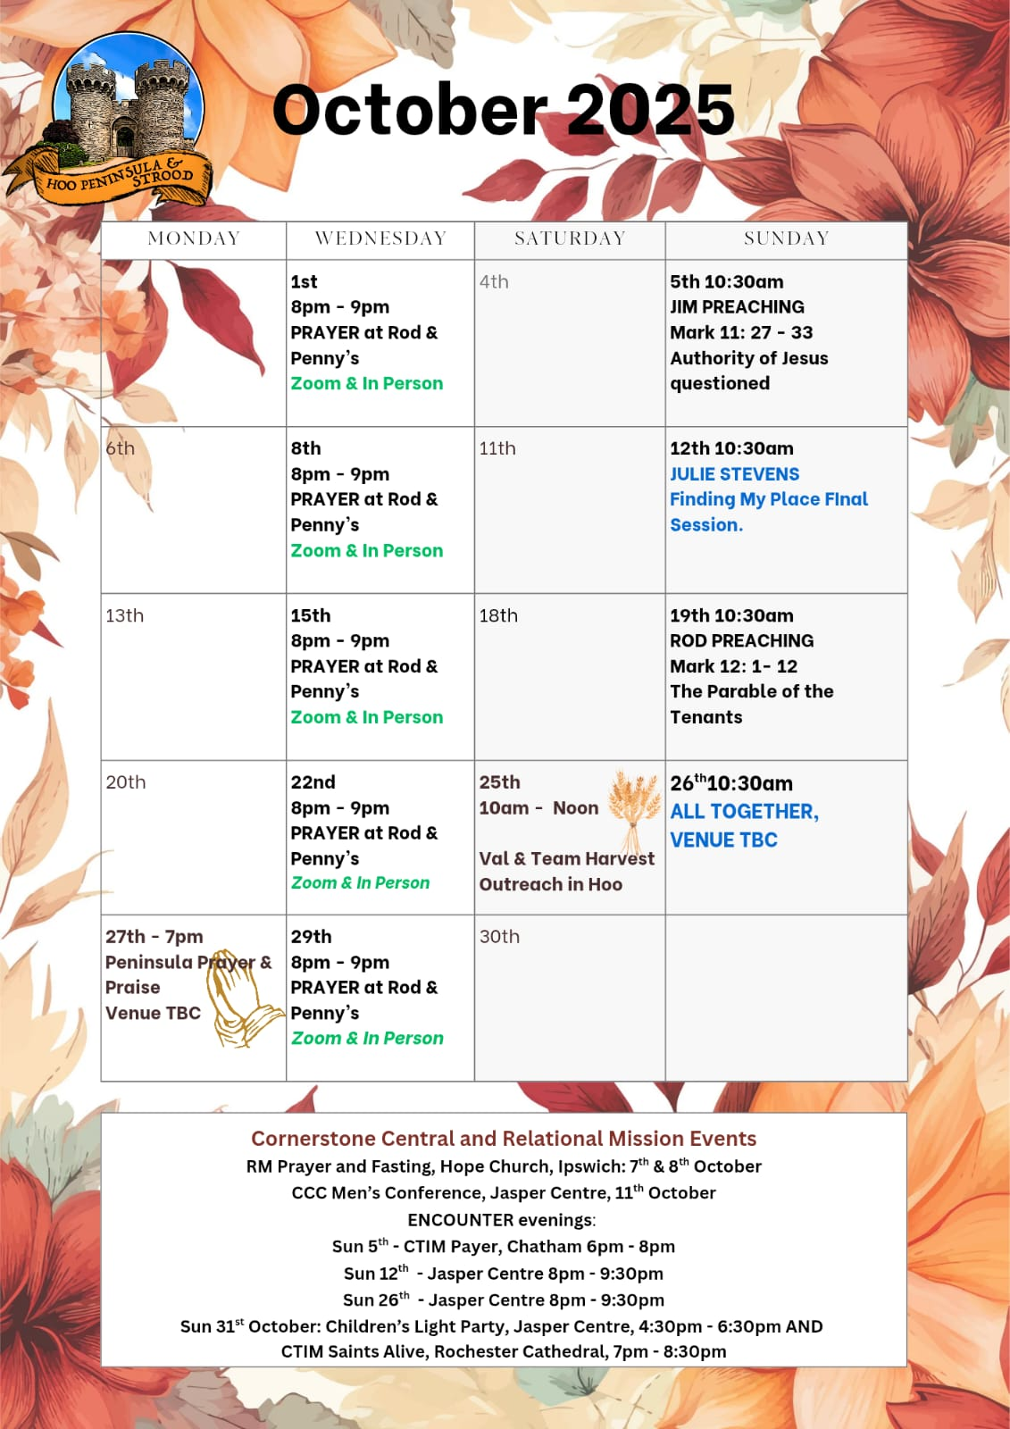

Slide 32
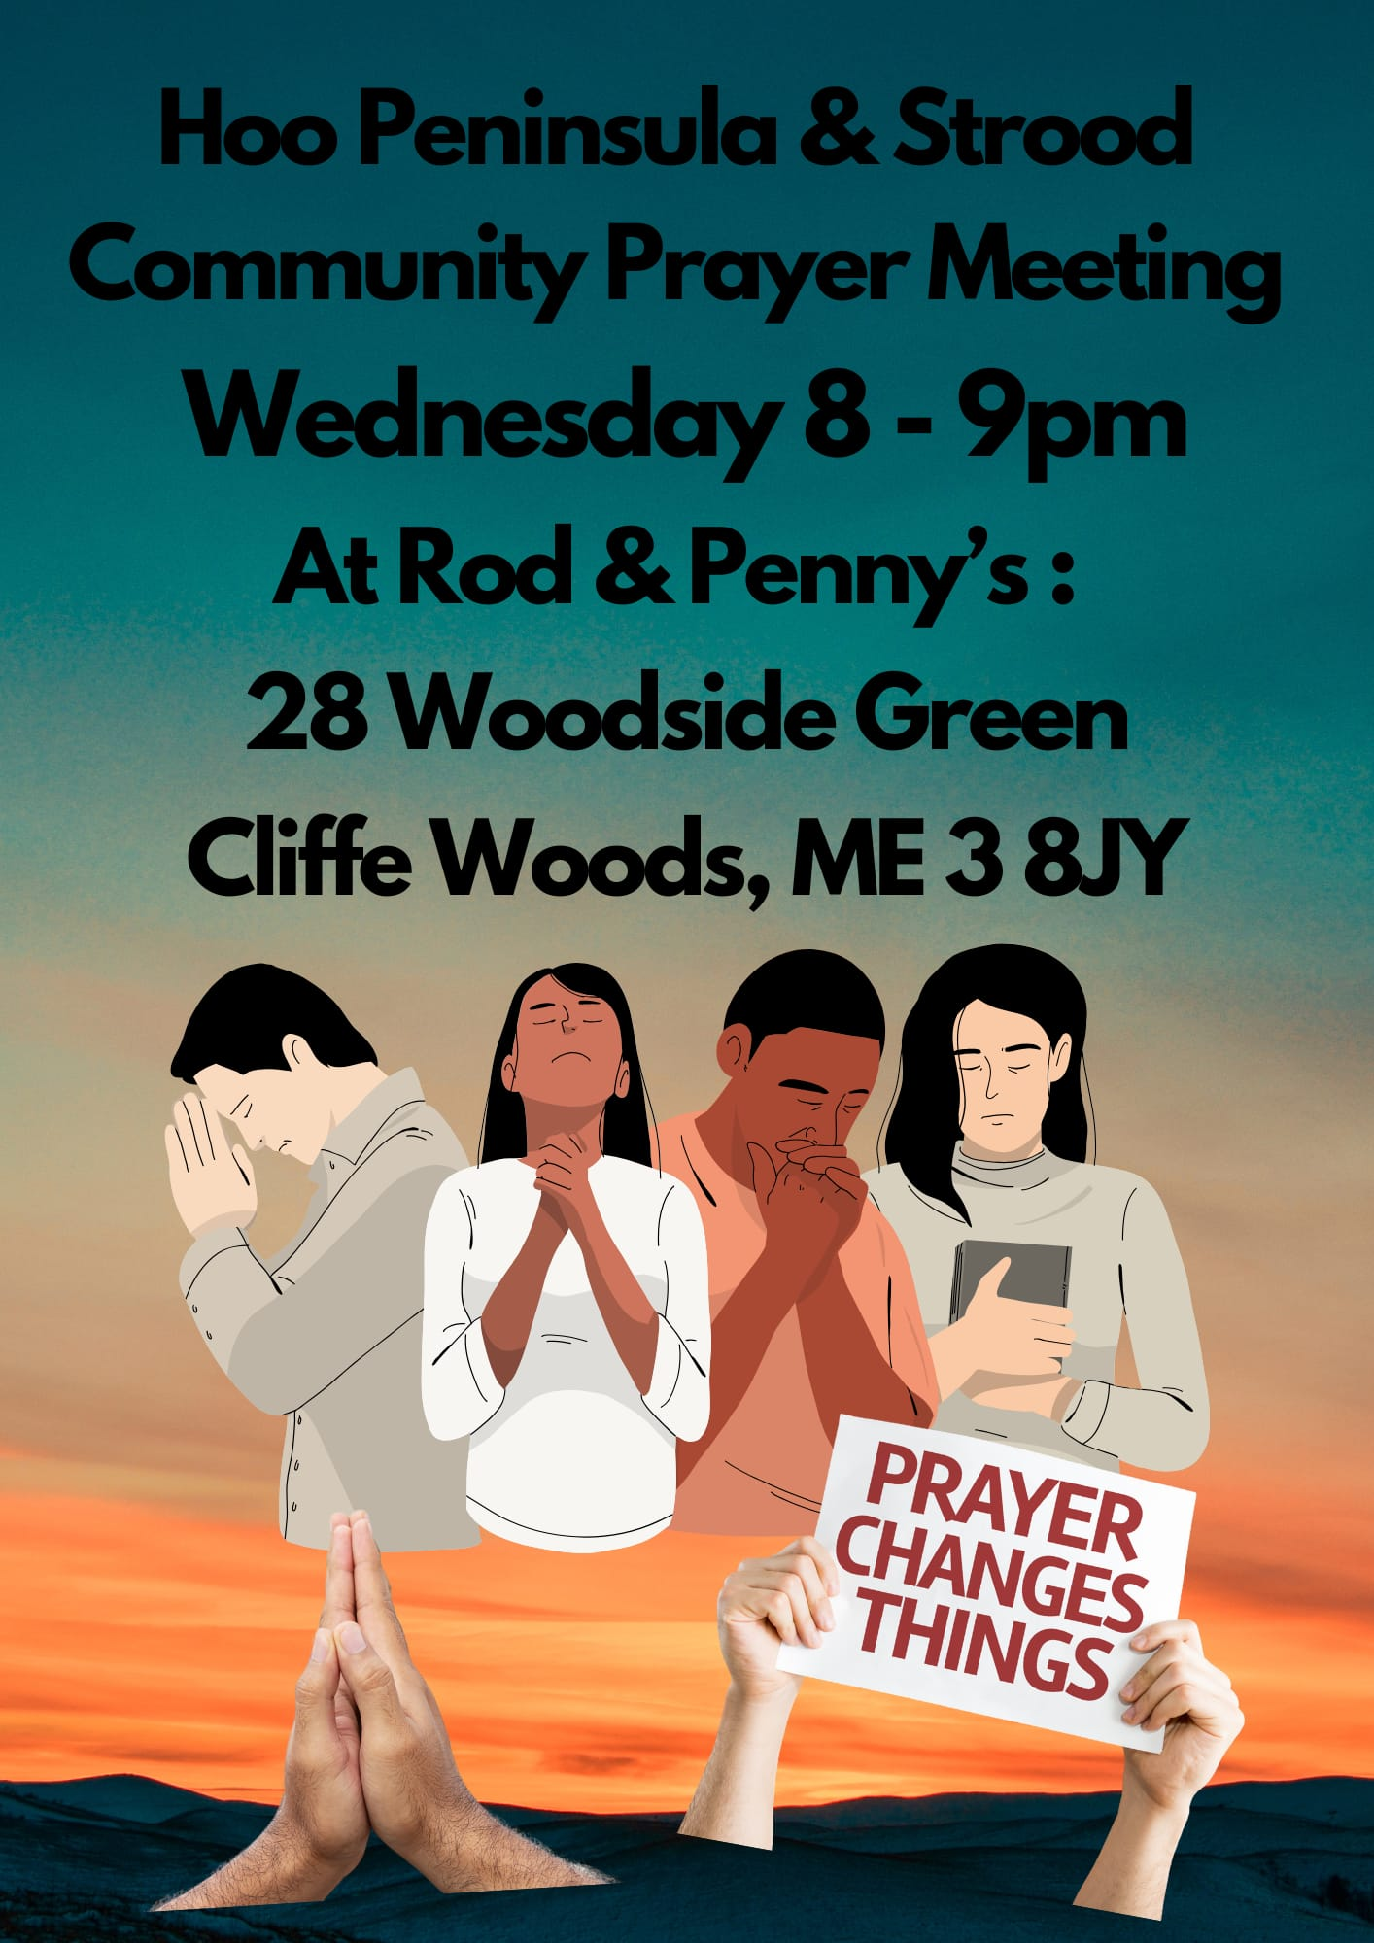

Slide 33
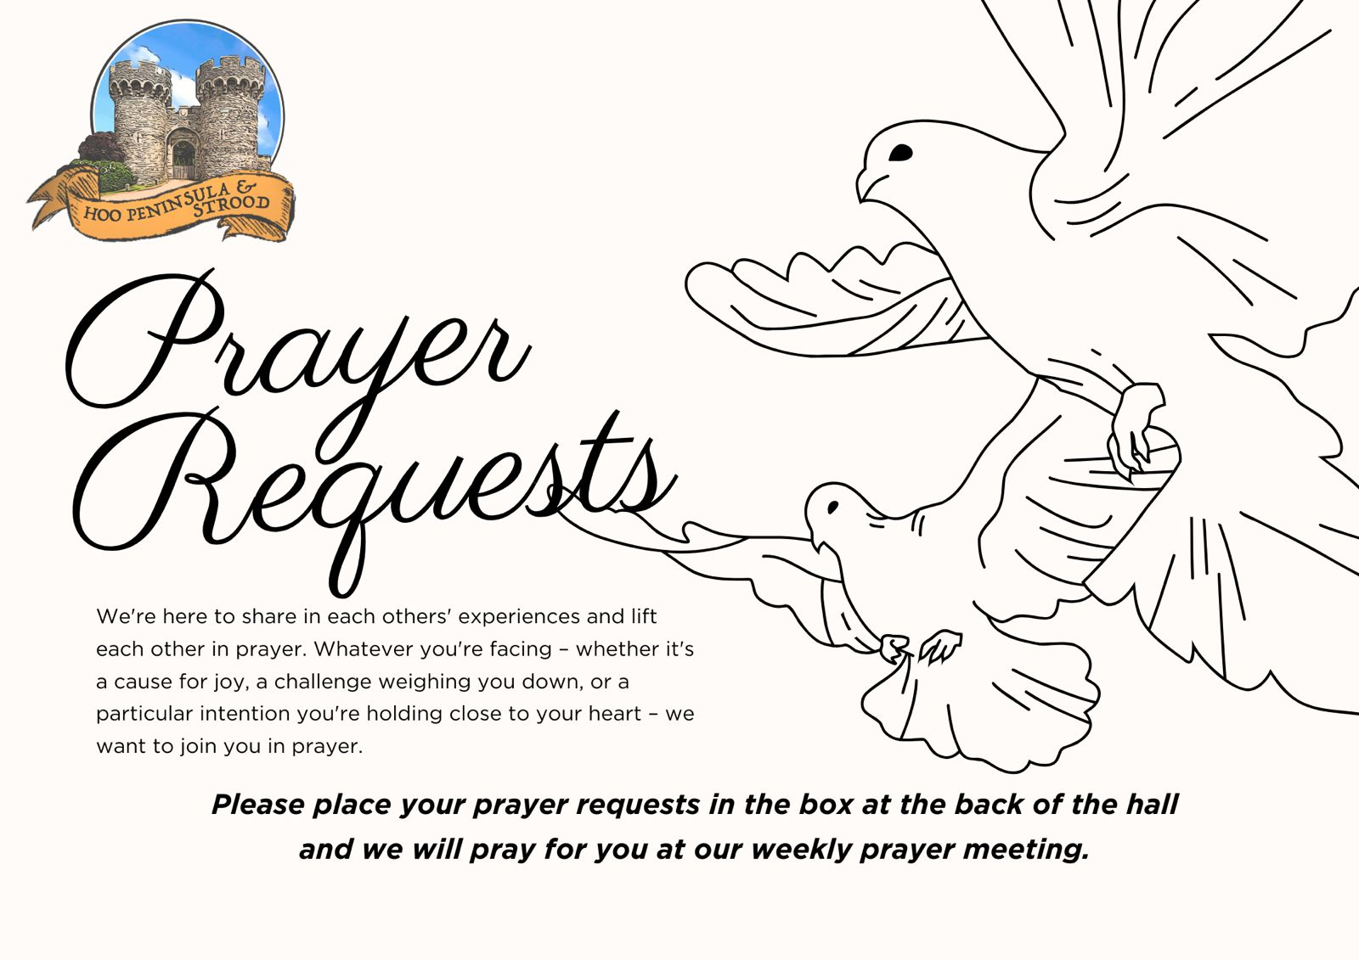

Slide 34

Grow Group 1
On YOUR MARK!

Slide 35
Leaders
Leaderss
Phil & Kim
Maria (Mia) Warren
Matthew Harrison
Richard & Elisha Acheampong
Phil & Kim
Maria (Mia) Warren
Matthew Harrison
Richard & Elisa Acheampong

Slide 36

Leaders
Phil & Kim
Maria (Mia) Warren
Matthew Harrison
Richard & Elisa Acheampong

Slide 37
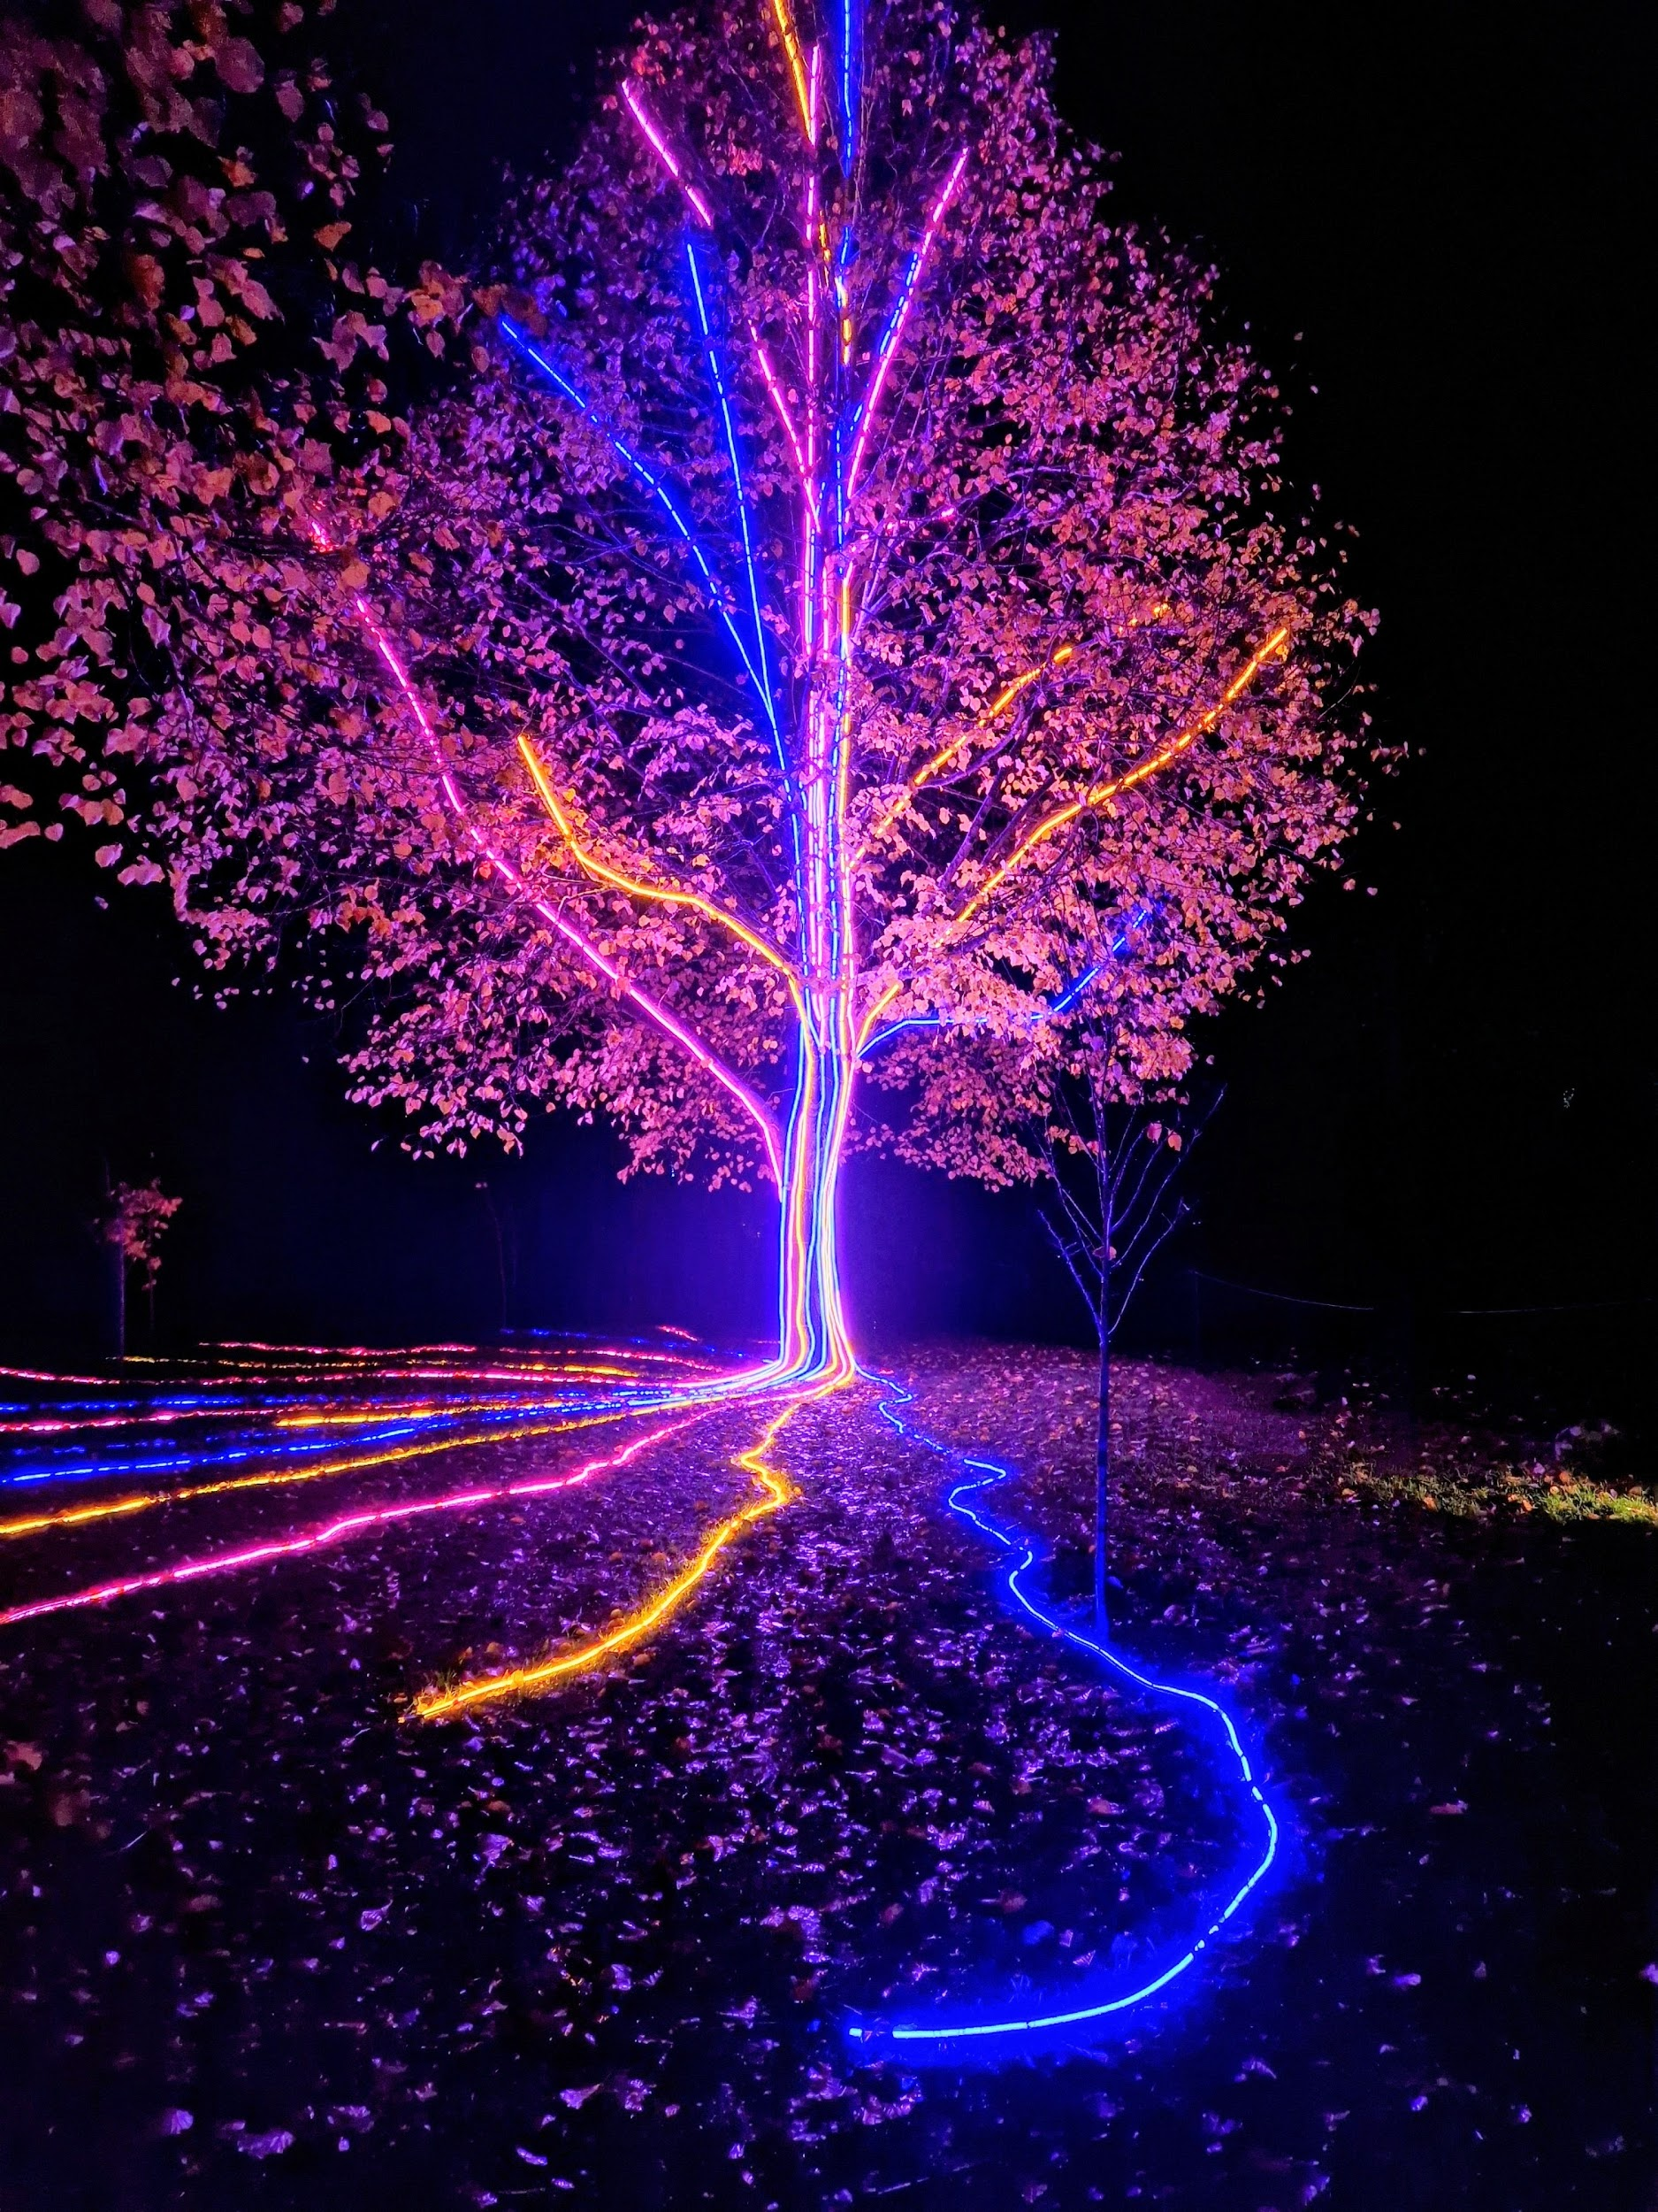
Storm Walker
Storm Walker
Symbolising, trust in Jesus Christ through life's storms.
Mark 4:35-41

Slide 38



Group Leaders
Micheal and Mwamba
Wilfred and Parveen
Hannah

Slide 39


Slide 40


Slide 41
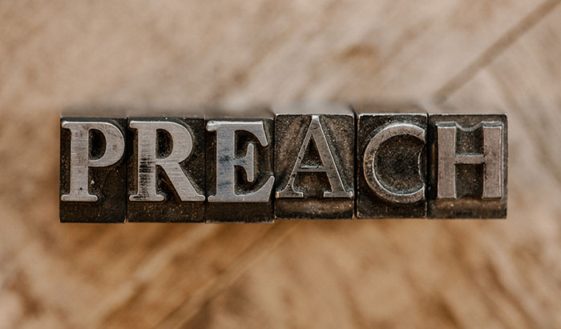

Slide 42
Behold Him
CCLI Song # 7133698
Mitch Wong | Paul Baloche
© 2019 A Wong Made Write Publishing; Integrity Worship Music; Integrity's Praise! Music; Leadworship Songs
For use solely with the SongSelect® Terms of Use. All rights reserved. www.ccli.com

Slide 43
1/7
He who was before there was light
Walked across the pages of time
He who made every living thing
Behold Him
He who heard humanity's cry
Left His throne to wake as a child
He became like the least of us
Behold Him

Slide 44
2/7
Jesus Son of God Messiah
The Lamb the roaring Lion
Oh be still and behold Him

Slide 45
3/7
He who dined with sinners and saints
Healed the blind the lost and the lame
Even now He is in our midst
Behold Him
He who chose a criminal's end
Paid with blood to settle our debt
Buried death as He rose to life
Behold Him

Slide 46
4/7
Jesus Son of God Messiah
The Lamb the roaring Lion
Oh be still and behold Him
Jesus Alpha and Omega
Our God the risen Savior
Oh be still and behold Him

Slide 47
5/7
Holy holy holy
Is the Lord God Almighty
Worthy worthy worthy
To receive all praise (REPEAT)

Slide 48
6/7
Jesus Son of God Messiah
The Lamb the roaring Lion
Oh be still and behold Him
Jesus Alpha and Omega
Our God the risen Savior
Oh be still and behold Him

Slide 49
7/7
Behold Him

Slide 50
2 Corinthians 14 May the grace of the Lord Jesus Christ, and the love of God, and the fellowship of the Holy Spirit be with you all
Surely goodness and mercy shall follow us all the days of our lives, and we shall dwell in the house of the Lord forever.

